Slide 1
Part 1: Python basic

Slide 2
CONTENTS
2
Part 1: Python basics
Getting Started with Jupyter Notebook
Variables and simple data types
Introducing lists, Tuples, Sets and Dictionaries
Conditional Statements and While loop
Function and class (OOP)

Slide 3
Functions
5.1. Functions
What are functions?
Defining a Function
Passing Arguments
Return Values
Passing a List
Passing an Arbitrary Number of Arguments
Modules

Slide 4
What are functions?
Functions are named blocks of code designed to do one specific job.
Functions allow you to write code once that can then be run whenever you need to accomplish the same task.
Functions can take in the information they need, and return the information they generate.
Using functions effectively makes your programs easier to write, read, test, and fix.

Slide 5
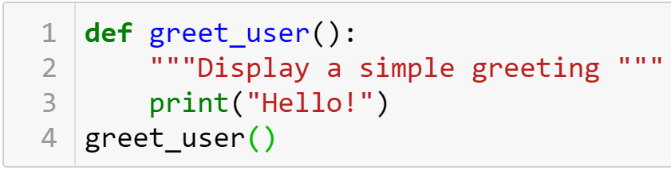

Defining a Function
The simplest structure of a function
keyword
The name of the function
Defining
Docstring
Body
Describes what the function does
Calling

Slide 6
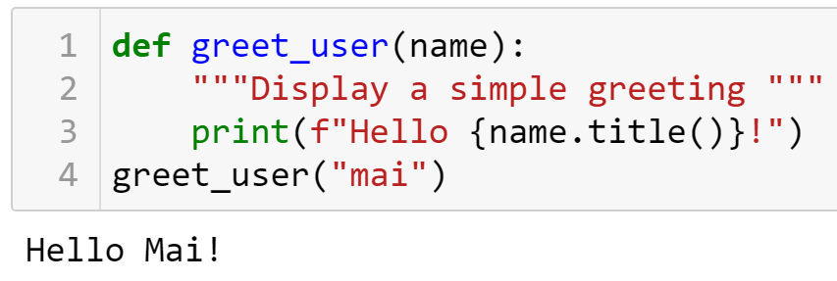


Defining a Function
Passing Information to a Function
Arguments and Parameters
Parameter
Argument

Slide 7
Practice
8-1,8-2

Slide 8
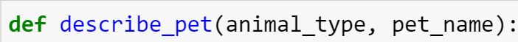
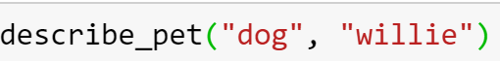
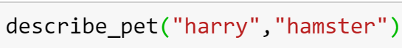
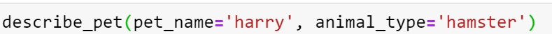
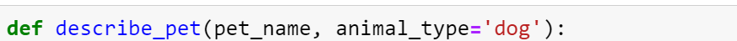
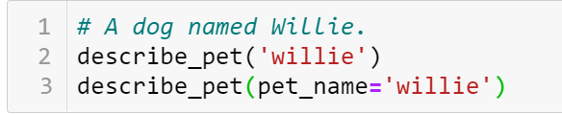
Passing Arguments
Positional Arguments
Using keyword arguments
Default Values
Equivalent Function Calls

Slide 9

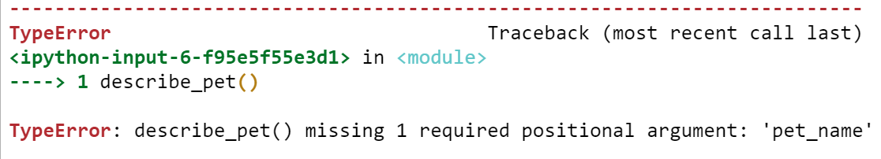
Passing Arguments
Avoiding Argument Errors

Slide 10
Practice
8-3,…,8-5

Slide 11
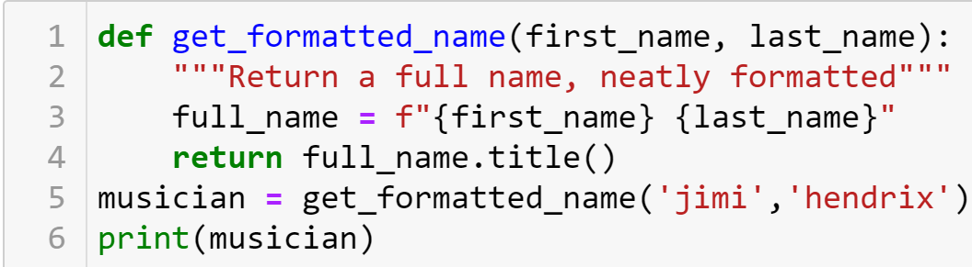

Return Values
Returning a Sinple Value

Slide 12
Return Values
A function can return a value or a set of values. When a function returns a value, the calling line should provide a variable which the return value can be assigned to.
A function stops running when it reaches a return statement.

Slide 13
Visualizing functions
http://pythontutor.com/

Slide 14
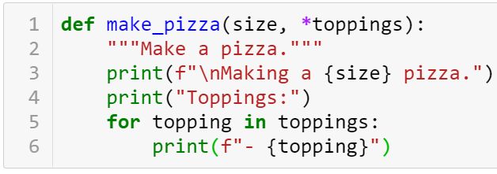
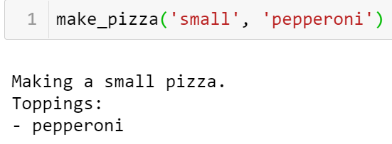
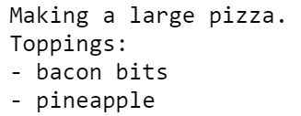
Passing an Arbitrary Number of Arguments
Sometimes you won't know how many arguments a function will need to accept. Python allows you to collect an arbitrary number of arguments into one parameter using the * operator .
A parameter that accepts an arbitrary number of arguments must come last in the function definition.
Collecting an arbitrary number of arguments

Slide 15
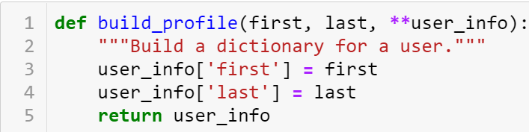
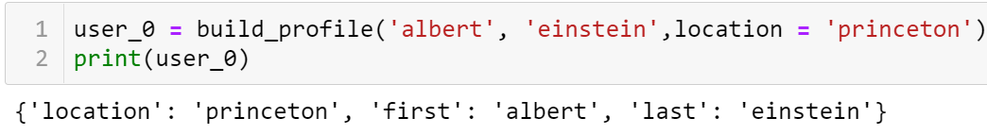
Passing an Arbitrary Number of Arguments
Collecting an arbitrary number of keyword arguments
The ** operator allows a parameter to collect an arbitrary number of keyword arguments.
These arguments are stored as a dictionary with the parameter names as keys, and the arguments as values.

Slide 16
Order of parameters
Normal parameters
*args
Parameters have default values
**kwargs

Slide 17
Practice
Exercise 1: Filter Prime Numbers using *args
Write a function that accepts n positive integers using *args to get a tuple of integers. The function will return a new list containing the prime numbers from the original list.
Exercise 2: Student Assessment
Write a function that takes a student's name and a list of scores via **kwargs and calculates the average of that student's scores.
Ex: student_info = {'name': 'Alice', 'scores': [85, 90, 92]}
calculate_average_score(** student_info)=?

Slide 18
Modules
Storing a function in a module
Importing an entire module
Importing a specific function
Giving a module an alias
Importing all functions from a module Don't do this, but recognize it when you see it in others' code. It can result in naming conflicts, which can cause errors.

Slide 19
Practice

